Slide 1

THE QUIZ GAME
GROUP MEMBERS:
JAWWAD
OWAIS
ASAD
TAHA
ABBAS
YOUR LOGO
ENCHANCE KNOWLEDGE IN A FUN WAY….
Notes:
© Copyright Showeet.com – Creative & Free PowerPoint Templates

Slide 2
INTRODUCTION
#
A QUIZ is a game which can also be called a mind sport wherein the players attempt to answer questions. Quiz games put the fun into learning. Your knowledge will be tested regarding a variety of subjects. Not only quizzes are fun for students, they are also a sneaky form of learning.
Notes:
© Copyright Showeet.com – Creative & Free PowerPoint Templates

Slide 3
PROGRAMMING TOOLS
Functions
Nested Loops
Conditional Statements
File Handling

Slide 4
FEATURES
The distinguishing features of our codes are mentioned below:
Admin can view the information like: (name, roll #) of the players.
The Quiz Game is based on three competitive rounds having individual criteria to qualify them.
Our project is totally based on the fundamentals/logics of programming considering the aim of our course.

Slide 5
PROGRAM FLOW
#
REGISTRATION:
The system has registration options for players who are new and old in the QUIZ..
It will take your personal information like: Name, Roll no. and Department….
Then your quiz will be started which contains 3 rounds.
ROUND #1:
Round #1 is a beginner level that contains basic questions.
Round #1 contains 10 questions each of 10 points and the player must be given correct answers of at least 7 questions to proceed to the next round otherwise the game will be over.
Notes:
© Copyright Showeet.com – Creative & Free PowerPoint Templates

Slide 6
PROGRAM FLOW
#
ROUND #2:
Round #2 is a slightly tough level that contains some tough questions than previous round questions.
Round #2 contains 5 questions each of 20 points and the player must be given correct answers of at least 4 questions to proceed to the next round lest the game will be over.
ROUND #3:
Round #3 is an advanced level that contains more difficult questions.
Round #3 contains 3 questions each of 50 marks and the player must be given correct answers of all the 3 questions to win the quiz game otherwise the game will be over.
Notes:
© Copyright Showeet.com – Creative & Free PowerPoint Templates

Slide 7
PROGRAM FLOW
#
SCORE:
After the player won round#3 player will get his total score with his all personal information.
Notes:
© Copyright Showeet.com – Creative & Free PowerPoint Templates

Slide 8
PSEUDO CODE:
# BY THE NAME OF ALLAH THE MOST BENEFICIAL AND THE MOST MERCIFUL
Start
Defining of the function info containing name, roll number and department:
------------ Writing the credentials of user in the file named info.txt
Defining Of the Function Round 1:
------------ Display round 1
------------ Read the files r1.txt and w1.txt
------------ Retrieve questions from file r1.txt
------------ Using nested for loop display all questions of round 1
---------------------- Take answers options as input from user
---------------------- If answers are same as in w3.txt:
------------------------------------Then add 10 score
---------------------- Else:
------------------------------------Print answer is incorrect
------------ After completion of loop
------------ Print the total score of round 1

Slide 9
PSEUDO CODE:
Defining Of the Function Round 2:
------------ Display round 2
------------ Read the files r2.txt and w2.txt
------------ Retrieve questions from file r2.txt
------------ Using nested for loop display all questions of round 2
----------------------Take answers options as input from user
--------------------------If answers are same as in w2.txt:
--------------------------------Then add 20 score
---------------------- Else:
--------------------------------Print answer is incorrect
------------ After completion of loop
------------ Print the total score of round 2
Defining Of the Function Round 3:
------------ Display round 3
------------ Read the files r3.txt and w3.txt

Slide 10
PSEUDO CODE:
------------ Retrieve questions from file r3.txt
------------ Using nested for loop display all questions of round 3
----------------------Take answers options as input from user
-----------------------If answers are same as in w3.txt:
---------------------------------Then add 50 score
-----------------------Else:
---------------------------------Print answer is incorrect
------------ After completion of loop
------------ Print the total score of round 3
Defining Of the Function Score:
------------ Print info with the final score which contains the score of all three rounds
Defining the Function Program:
------------ Take input yes/no from user as input for the question are you ready to play?
------------ If user responds yes:

Slide 11
PSEUDO CODE:
------------------------Print welcome to quiz
------------------------ Then Take info from user as input
------------------------ And recall the function round 1 of the quiz
------------------------ If round1 score is greater than or equal to 70:
----------------------------------- Then recall the function round 2 of the quiz
-----------------------------------If round2 score is greater than or equal to 80:
-----------------------------------------------Then recall the function round 3 of the quiz
-----------------------------------------------If round3 score is 100%:
----------------------------------------------------------------Then Print congratulations
----------------------------------------------------------------And Recall The Score Function.
---------------------------------------------Else:
------------------------------------------------------- print oops! You are disqualify. Better luck next time :(

Slide 12
PSEUDO CODE:
-------------------------------------Else:
------------------------------------------------- print oops! You are disqualify. Better luck next time :(
------------------------- Else:
-------------------------------------print oops! You are disqualify. Better luck next time :(
------------ Print Whole Program Function
Print BYE_BYE
# END OF CODE

Slide 13
LEARNING
We have learnt a lot of new things while working on this project, like we have learnt:
After having difficulties in opening a file, we finally learnt to open a file.
Have learnt use of many different functions.
And lastly we have learnt how to do team work which increased our knowledge and skills a lot.

Slide 14
GROUP MEMBERS AND CONTRIBUTIONS
S M JAWWAD
M.TAHA KHAN
01
04
(CT-076)
CONTRIBUTION:
Main idea of the project and implementation of all round functions in quiz using conditional statements and loop..
(CT-079)
CONTRIBUTION:
Write syntax of the code, created project presentation and also contributed in file handling.
02
ASAD ULLAH
(CT-089)
CONTRIBUTION:
Identify the bugs in the code and debug them, performed file handling in the quiz and updating scores using loop..
05
ABBAS RAZA
(CT-075)
CONTRIBUTION:
Created file of all questions asked in the quiz and flow chart, contributed in creating presentation.
03
M.OWAIS ANSARI
(CT-069)
CONTRIBUTION:
Implemented conditional statements in the quiz and created pseudo code and report of the program.
Notes:
© Copyright Showeet.com – Creative & Free PowerPoint Templates

Slide 15
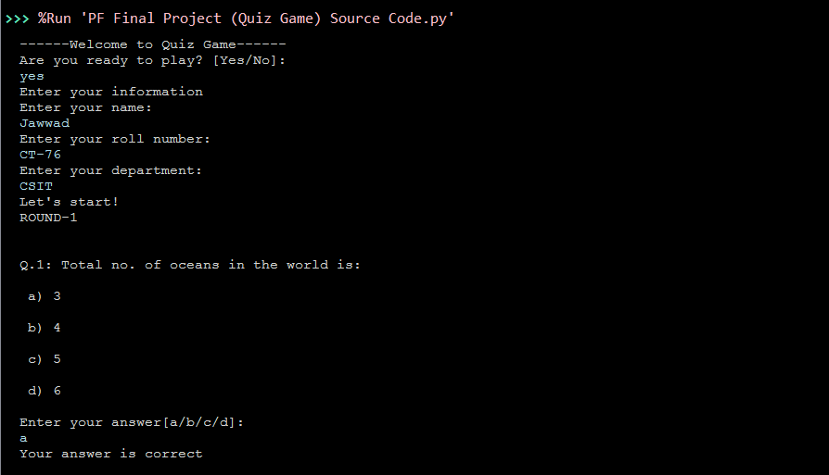
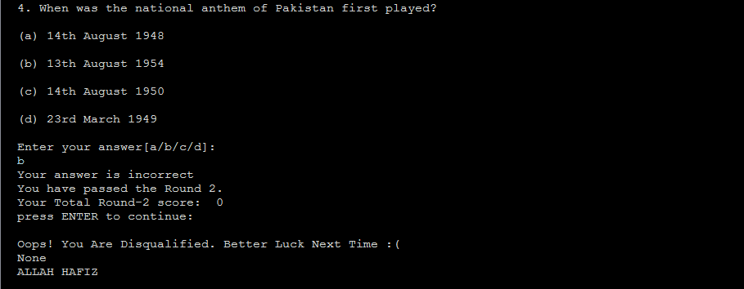
OUTPUT!
Notes:
© Copyright Showeet.com – Creative & Free PowerPoint Templates

Slide 16
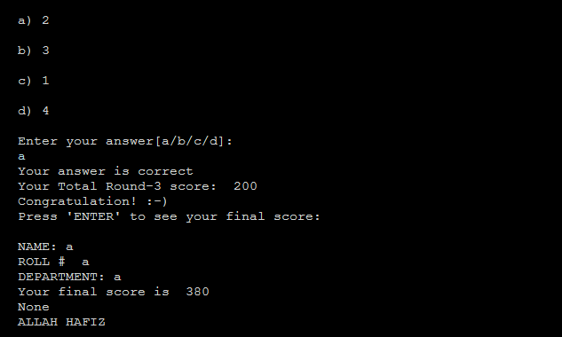
OUTPUT!

Slide 17
Thank You !
Notes:
© Copyright Showeet.com – Free PowerPoint Templates

